Slide 1
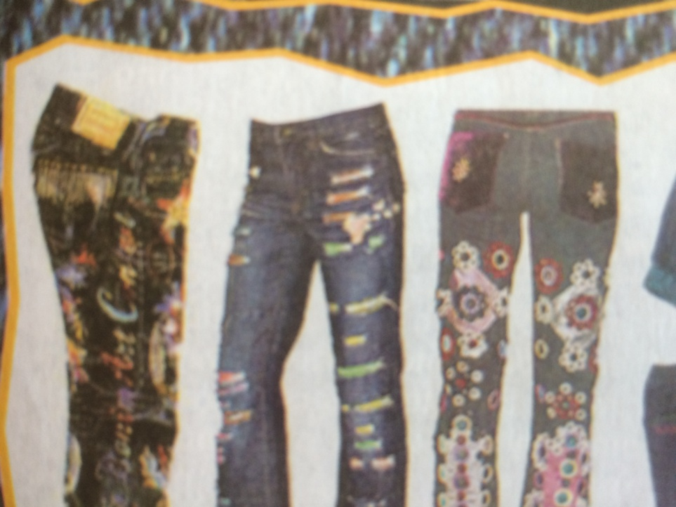
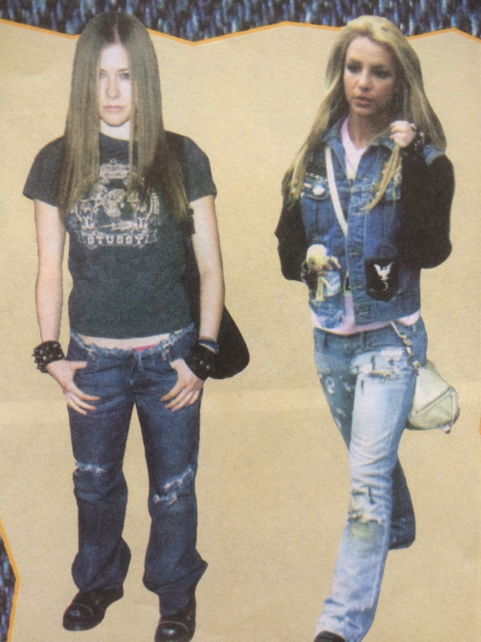
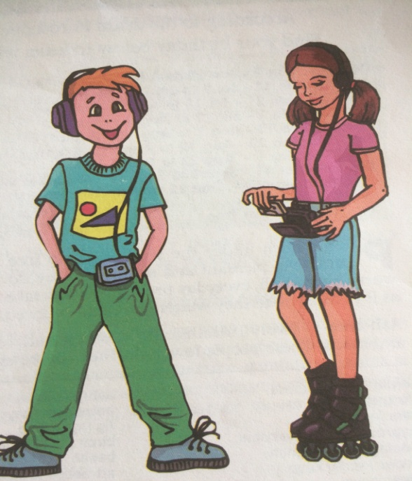
Teenager

Slide 2
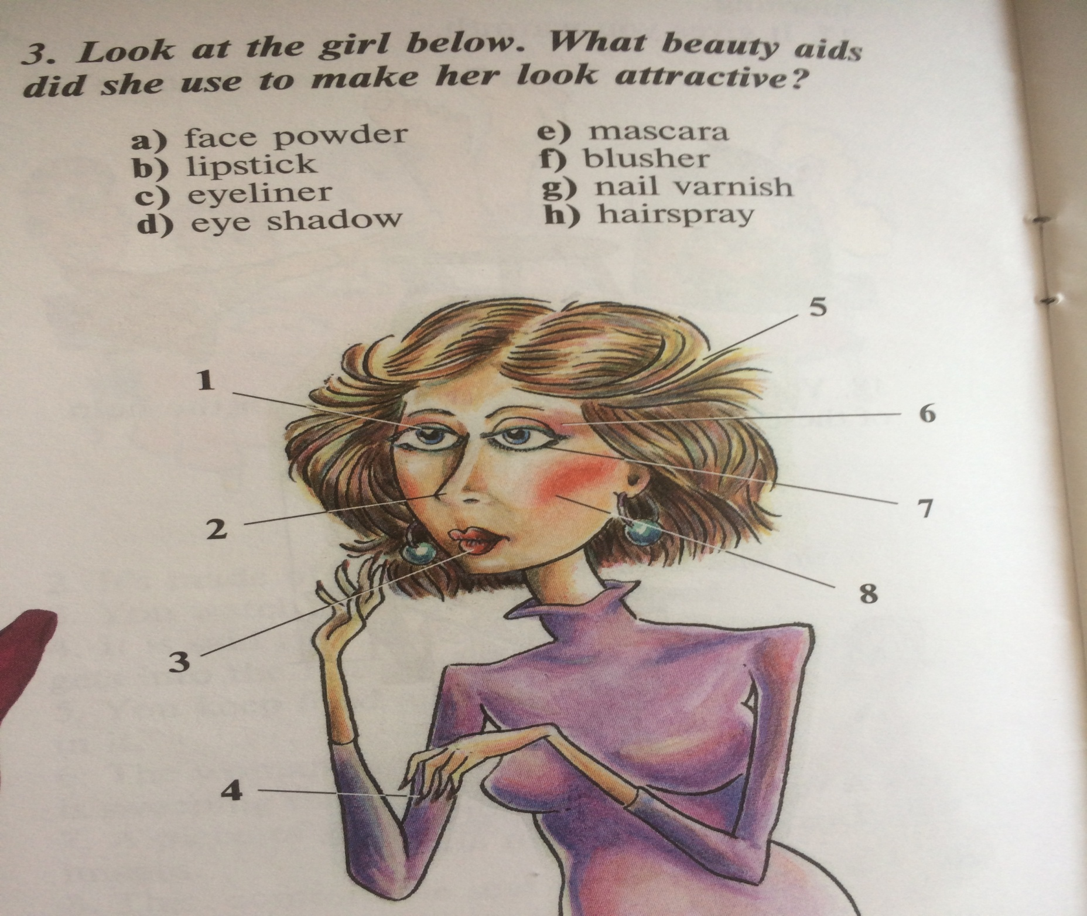

Slide 3
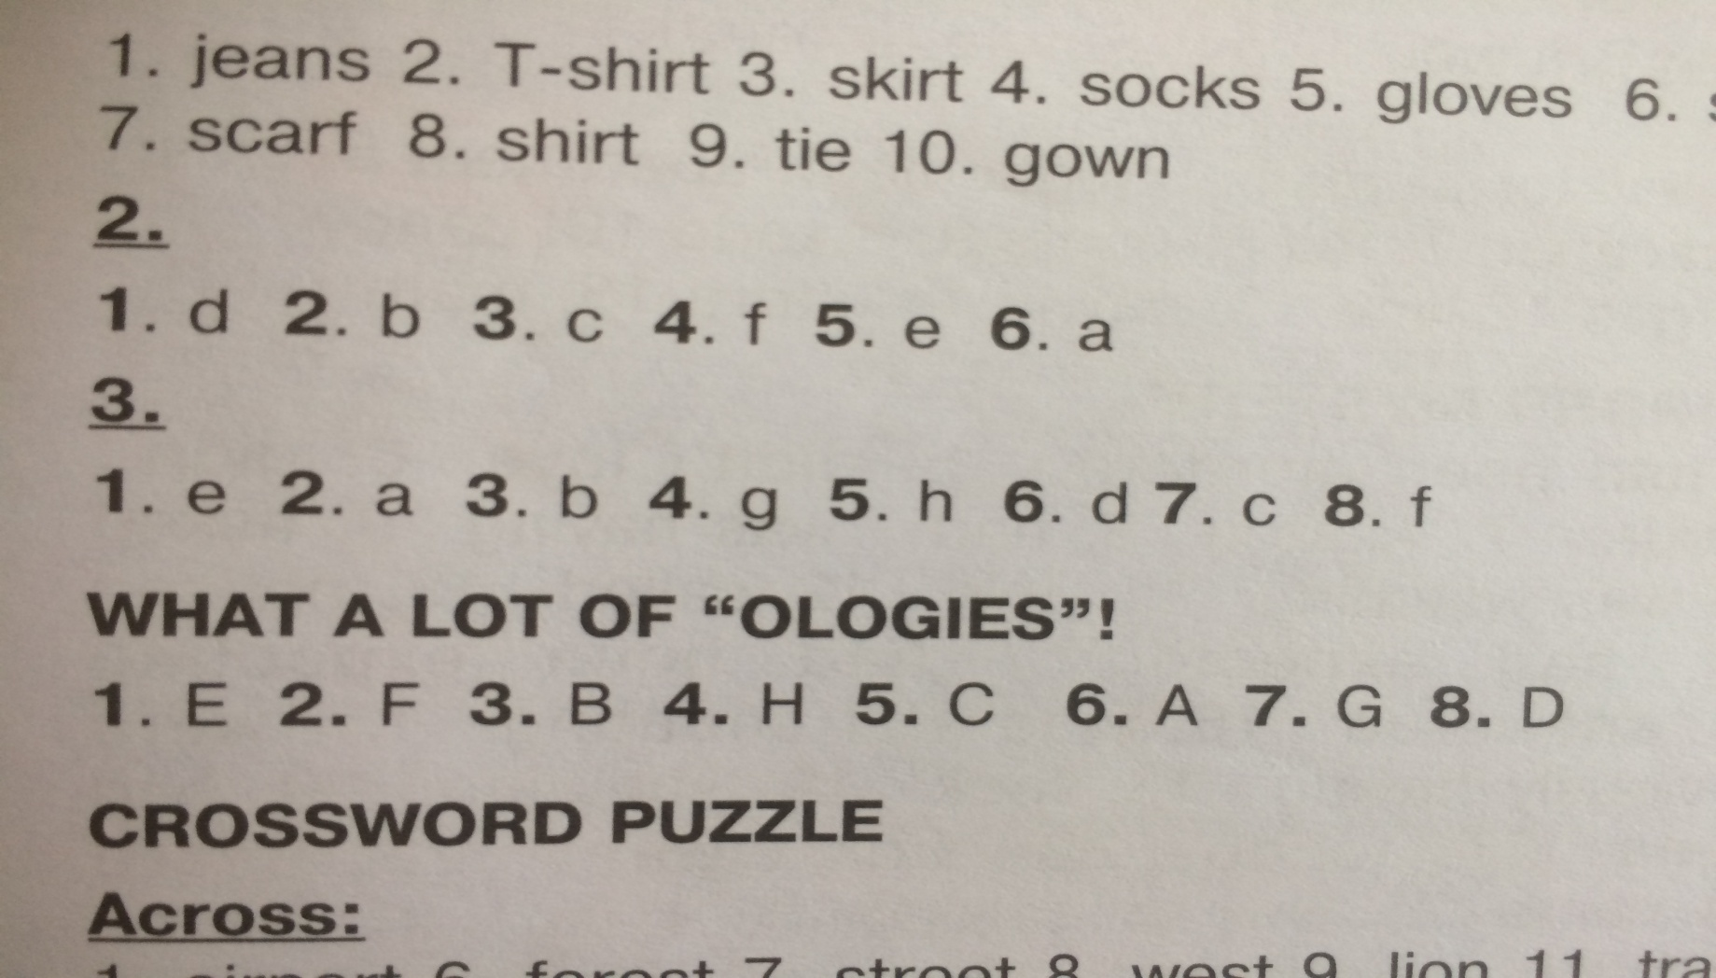
Key

Slide 4
Read the words
Add on, put on, look, see, notice, pay, unlikely, ignore, refuse, cause, influence, causative form, chest, heart, leg, knee, toe, ankle, wrist, shoulder, stomach, waist, hips, eyes, mouth, ears, lips, nose, hair, head, hand , foot.

Slide 5
Key ex1 p64
The pictures are of Brad Pitt and Penelope Cruz. They are famous film stars. They are popular all over the world. The title of the text is ‘Altered Images’ which means that pictures are changed, probably to make famous people like Brad Pitt and Penelope Cruz look even better than they are.

Slide 6
Key ex 2a p64
1B 2D
3A 4A
5C 6D

Slide 7
Key ex2b p64
The purpose of the text is to explain why famous people in the media always look so good and to persuade us not to let their pictures make us feel bad about ourselves.

Slide 8
Key for hometask
Ex 4 p63
1 with 2 by 3 by 4 with 5 by
Ex 5 p 63
1 The opera house will be opened next week. 2 He wasn’t invited to the party. 3 The food is being prepared by the chef. 4 The costumes were designed by Donna Karan. 5 The article hasn’t been checked yet by the editor.

Slide 9
Key ex3 p 64
A2, B1 Sentence B means that someone else is doing something for someone Causative form
Have+object+past participle
We use the causative form to show that someone else does something for someone.

Slide 10
Key ex.4 p.65
2 A: Have you ever had your teeth straightened?
B: Yes, I have. 3
A: Have you ever had your nails done?
B: Yes, many times. 4
A: Have you ever had a hair extension added?
B: No, I haven’t. 5
A: Have you ever had your teeth whitened?
B: No, I haven’t. 6
A: Have you ever had your hair dyed?
B: Yes, I have. 7
A: Have you ever had your eyes checked?
B: Yes. I get them checked every two years. 8
A: Have you ever had an x-ray taken?
B: Yes, several times.

Slide 11
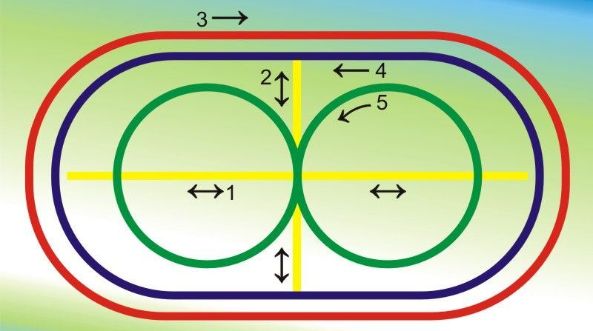
Dynamic pause

Slide 12
Key ex5 p 65
1 is having her hair straightened
2 is having her make up done
3 have false nails put on
4 has had his teeth whitened
5 ’m having my eyes tested
6 have my hair cut

Slide 13
Key ex.6 p.63
2 She will have a dress made.
3 He had his car fixed yesterday.
4 She had her nails done yesterday.
5 He’s having his shoes mended.
6 She’s having the house painted.
7 He’s having his suits cleaned.
8 They’re having the film developed.

Slide 14
Key ex.7a p.65
chest, heart, leg, knee, toe, ankle, wrist, shoulder, stomach, waist, hips, eyes, mouth, ears, lips, nose etc

Slide 15
Key 7b p.65
1 hair 3 leg 5 hand 2 fingers 4 head 6 foot
1 pulling your leg
2 put her foot down
3 keep my fingers crossed
4 lost her head
5 made my hair stand on end
6 give me a hand

Slide 16
Hometask
WB ex3,5 p 37
SB ex 6 p 65 WB ex4 p 37

